Slide 1
SCTP v/s TCP – A Comparison of Transport Protocols for Web Traffic
CS740 Project Presentation
by
N. Gupta, S. Kumar, R. Rajamani

Slide 2
Outline
Motivation
Introduction to SCTP
Server Architecture
Experimental Design
Parameters
Results
Conclusion

Slide 3

Motivation
Many applications need reliable message delivery – they do so by delineating a TCP stream
TCP provides both strict-ordering and reliability – many applications may not need both

Slide 4

Motivation (contd)
HTTP is one such application
  While transferring multiple embedded files we only want
    Reliable file transfer for each file
    Partial ordering for the packets of each file but not total ordering amongst all the packets
  TCP provides more than this (but overhead?)
  SCTP may help (how? – later)

Slide 5
What is SCTP?
Originally designed to support PSTN signaling messages over IP Networks
It is a reliable transport protocol operating on top of a connectionless packet network such as IP (same level as TCP)

Slide 6
Major Differences from TCP
SCTP is message oriented as opposed to being byte stream oriented
SCTP has the concept of an association instead of a connection
  Each association can have multiple streams
SCTP separates reliable transfer of datagrams from the delivery mechanism
SCTP supports multihoming
Connection Setup

Slide 7
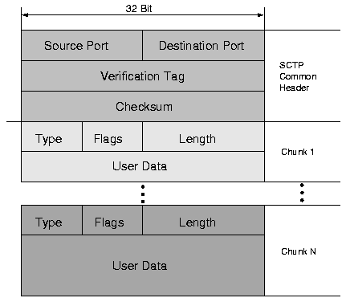
Packet Format

Slide 8
Similarities to TCP
Similar Flow Control and Congestion Control Strategies employed
  Slow Start and Congestion Avoidance phases
  Selective Acknowledgement
  Fast Retransmit
  Slight differences for supporting multihoming
Will allow co-existence of TCP and SCTP [JST 2000]

Slide 9
HTTP Server Architecture
Single File Transfer ( Both TCP and SCTP are similar)
Client
Server
Request file
Fork child
Child
process
Send file

Slide 10
HTTP Server Architecture
Multiple File Transfer (Embedded files) - TCP
Client
Server
Request file 0
Fork child
Send file 0
Child
process
Request file 1..N
Send file 1,2,…N

Slide 11
SCTP Packet Format
streams

Slide 12
HTTP Server Architecture
Multiple Files Transfer (Embedded Files) - SCTP
Client
Server
Request file 0
Fork child
Send file 0 – stream 0
Child
process
Request files 1..N
Send file 1 – stream 1
Send file N – stream N

Slide 13
The Scientific Method
Observation – HTTP does not require strict-order of delivery, when fetching embedded links. Also, HTTP is message-oriented protocol
Hypothesis and Predictions – SCTP provides partially ordered delivery and guarantees reliability. This can reduce user-perceived latency and improve throughput

Slide 14

Hypothesis
Server
Client
1
3
2
1
3
2
1
3
2
1
File 3
File 2
File 1
TCP
Receive buffer in kernel

Slide 15
Hypothesis
Server
Client
1
3
2
1
3
2
1
3
2
1
File 3
File 2
File 1
SCTP
Receive buffer in kernel

Slide 16
Experimental Design
FreeBSD kernel implementation of SCTP and TCP Reno
HTTP 1.1 Server and Client
  Similar implementations for TCP/SCTP
Dummynet to simulate interconnection network

Slide 17
Our setup
Server
Client
Dummynet configured with different b/w, delay and loss characteristics

Slide 18
Parameters
We observe latencies for single file and multiple file transfers by varying the following parameters
  Loss rate (0%, 1%, 2%, 5%, 8%, 10%, 15%, 20%, 25%)
  Link Bandwidth (40kbps, 400kbps, 3mbps,10mbps)
We keep Latency constant (80ms)

Slide 19
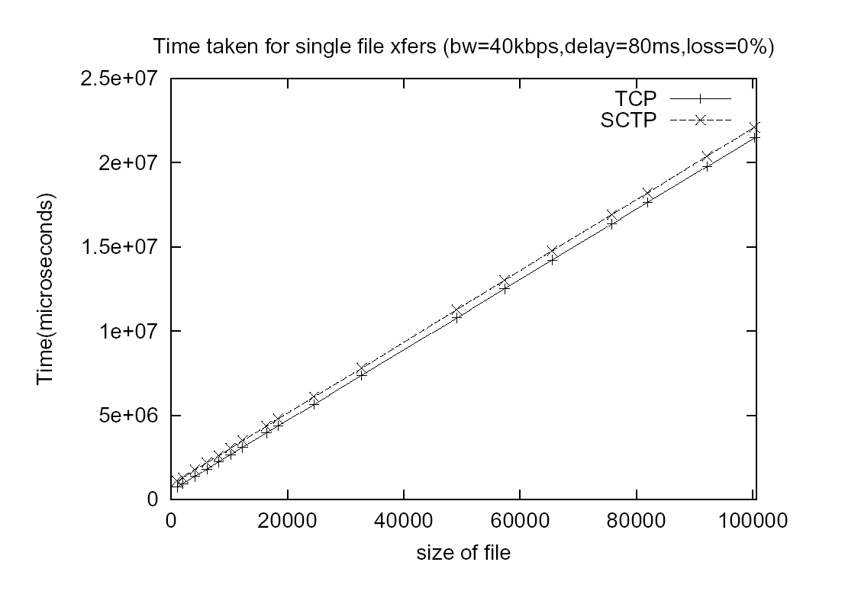
Results

Slide 20
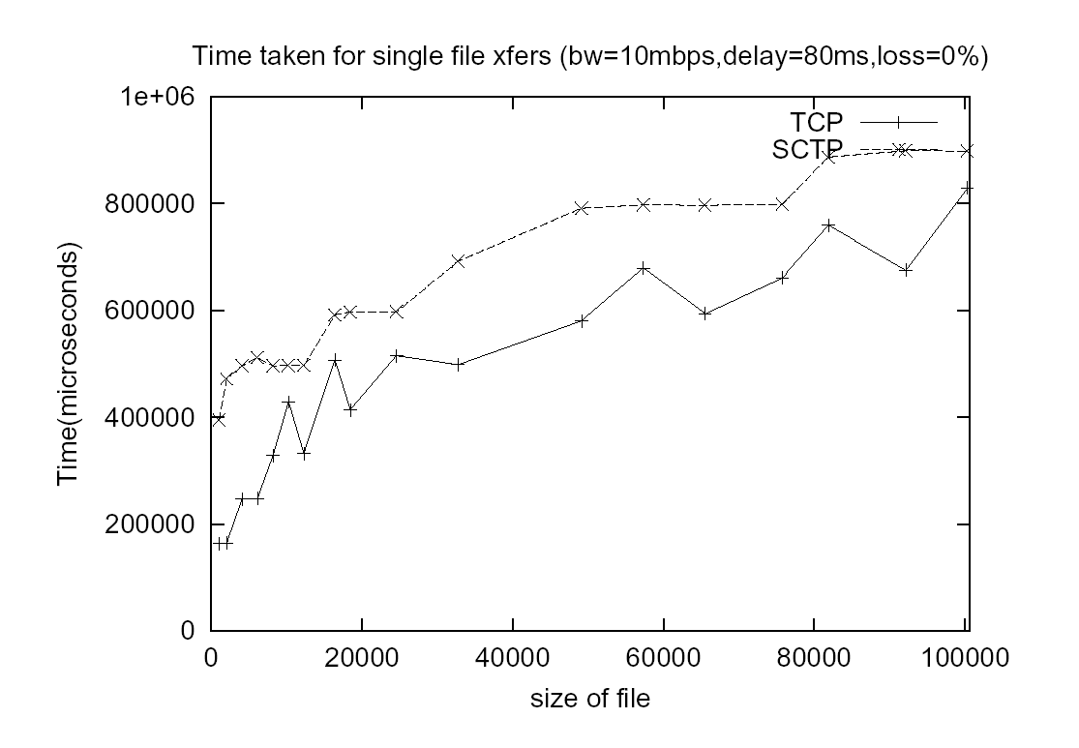
Results

Slide 21
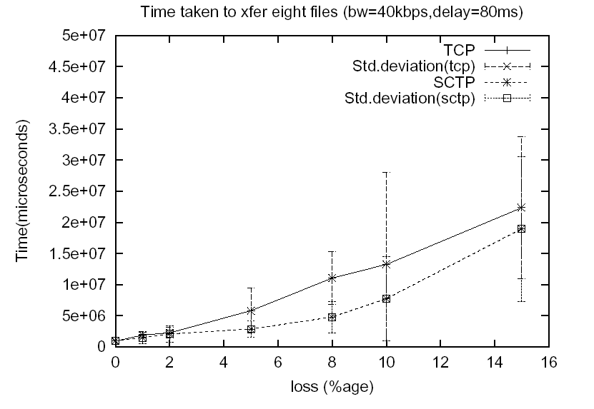
Results

Slide 22
About Errors
Loss in this direction 1%
Loss in this direction 1%

Slide 23
Reason
Server
Client
3
2
1
3
2
3
2
1
3
2
1
1
File 3
File 2
TCP
Send buffer in kernel
TCP
Receive buffer in kernel

Slide 24
Reason
Server
Client
3
3
2
2
3
2
1
3
2
1
1
1
File 3
File 2
SCTP
Receive buffer in kernel
SCTP
Receive buffer in kernel

Slide 25
Conclusions
The current SCTP implementation performs almost as well as TCP when there are no losses – However, there is an extra overhead in sending messages instead of just a stream of bytes
SCTP seems to perform better in the presence of losses, because it does not enforce strictly ordered delivery
More graphs available at http://www.cs.wisc.edu/~raj/sctp

Slide 26
Implications
SCTP can be a viable transport protocol for HTTP traffic, because –
  It helps reduce user-perceived latency and also improves throughput
  Uses a 4-way handshake and also uses an encrypted cookie, which offer better protection against SYN floods and DoS attacks
  Multihoming feature can be exploited to transparently allow mobile users to switch between networks

Slide 27
References
[CT90] D. Clark and D. Tennenhouse, Architectural Consideration for a New Generation of Protocols, In Proc. of ACM SIGCOMM '90.
RFC 2960 (http://www.rfc-editor.org)
http://tdrwww.exp-math.uni-essen.de/pages/forschung/sctp_fb/
[JST 2000] A. Jungmaier, et. al, Performance Evaluation of the Stream Control Transmission Protocol, In Proc. of the IEEE conference on High Performance Switching and Routing, June 2000.

Slide 28
Acknowledgements
Paul Barford
Doug Thain
Jim Gast, Joel Sommers, Winfred Byrd, CSL
Randall Stewart, Jon Grimm, La Monte Henry Piggy Yarroll

Slide 29
Questions?

Slide 30
Server Architecture
Single File Transfer
  Server forks a child process for each request
  Child parses the request and sends the requested file or an appropriate error message
  Similar for both TCP and SCTP

Slide 31
Server Architecture contd.
Multiple File Transfer (embedded files)
  TCP
    Child process at server parses the request and sends the requested file
    Client parses the received file and sends the requests for embedded files
    Child process at server receives these requests and sends the files one after other using persistent connection

Slide 32
Server Architecture contd.
Multiple files transfer (embedded files)
  SCTP
    Child process at server parses the request and sends the requested file
    Client parses the received file and sends requests for embedded files
    Child process at server receives the requests and sends the files on different streams within the same association
      Major difference from TCP

Slide 33
Server Architecture
Single File Transfer ( Both TCP and SCTP are similar)
Client
Server
request
Fork child
Child process
response

